Slide 1
One path to purpose . . .
Aitan Grossman
Notes:
My generation has a unique stake in our planet’s future.
As Vice President Al Gore puts it, a stake that provides the world a “powerful force of moral clarity”
These words have stayed with me for much of my youth
President Guy Djoken has honored me with an invitation to this Summit on Global Ethics to share with you this morning my path to creating “The Future We Want”

Slide 2
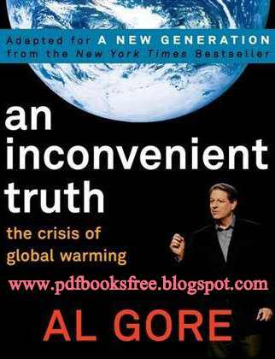
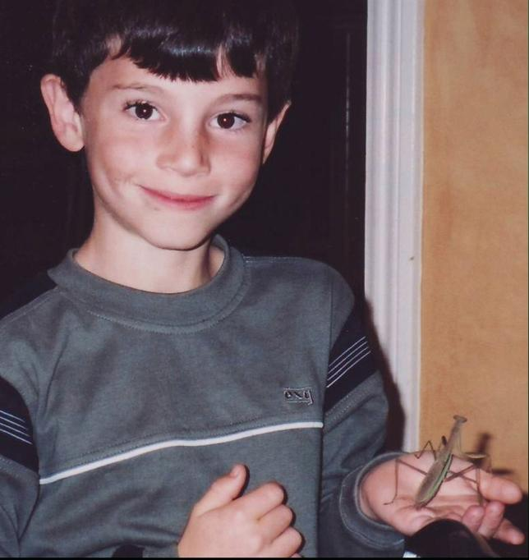
8 years old
Notes:
- Like most third graders, the world absolutely fascinated me.
- That year the thing that fascinated me most was Manti, a 1 inch praying mantis I found outside my bedroom window and kept as a pet
[pause]
- One Saturday morning that year my life changed.
- That morning
o my parents gave me this book – “an inconvenient truth” written by Al Gore
o I learned
▪ about the vast destruction of the earth adults had inadvertently caused and
▪ about the harm that was being done to animals like Manti and their habitats
- That morning:
o I knew I had to do something to help.

Slide 3
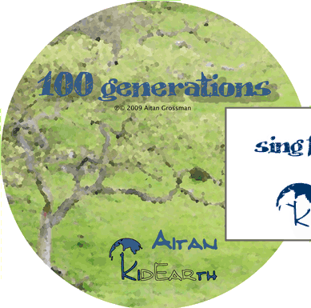
12 years old
“What ‘100 Generations’ says is that nature is eternal but we are destroying it. We have to keep it good for all our children and their children.”
- Aitan (2010)
:
Notes:
Fast forward 4 years – age 12:
My first attempt to do something big was a project I called kidEarth – where I married my love for music with environmental action.
- I wrote a song about global warming called "100 Generations"
- With help from family and friends I recorded it with 100 children from around the world and
- I distributed it on iTunes and the internet for other children to sing – in their language or mine – so we could raise awareness about climate change together

Slide 4
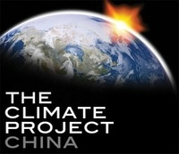
Your generation’s “unique stake” in our planet’s future provides the world a “powerful force of moral clarity.”
- US Vice President Al Gore to Youth at TCP’s International Presenters Training Session (June 27, 2010 in Nashville, Tennessee)
Notes:
Word of “100 Generations” made its way to Vice President Al Gore’s The Climate Project
and
earned me an invitation to join a dozen teens and hundreds of adults in Tennessee to listen to Mr. Gore speak about raising awareness about climate change.
For 3 days – 12 hours a day – we learned about climate science and climate politics from experts and saw hundreds of Mr. Gore's slides that showed in graphic detail:
- the harm climate change has inflicted on our planet and
- how we could reverse that.

Slide 5
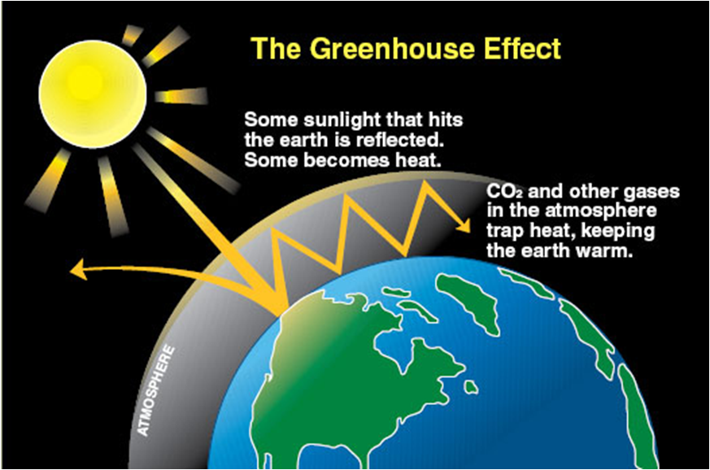
Notes:
These next slides are a crash course on what you need to know to give context to my WFUCA project – a regenerative bicycle brake.
The Greenhouse Effect
- When the sun's rays hit the earth, most of the rays would be reflected back into outer space if it weren't for certain gases in the atmosphere called "greenhouse gases"
- The most common greenhouse gases are CO2 and water vapor and they help keep the earth warm and from freezing over.
- But if there is too much CO2 in the atmosphere –trapped in the air above us – the earth heats up even more

Slide 6
Notes:
- This slide, from Mr. Gore’s presentation, shows how CO2 and the earth’s temperature have risen over the last 2000 years
- Look at the right side of each graph:
o Recently there has been a steep increase in both CO2 and temperature and
o It has been found that higher CO2 concentrations are largely responsible for this spike in global temperatures.
- Higher temperatures have a whole range of adverse effects on our environment
o Hotter oceans change weather patterns:
▪ Changed weather patterns mean more hurricanes and storms that cause floods and destroy communities
▪ Changed weather patterns mean forest fires and droughts that parch farmland and reduce access to drinking water
▪ Changed weather patterns mean destroyed habitats leading to extinction of some species
- Higher temperatures also melt glaciers which
o raise sea levels and
o decrease the number of rays that bounce off of the earth's surface and back into outer space
o which increases the greenhouse effect – raising earth’s temperature - even more

Slide 8
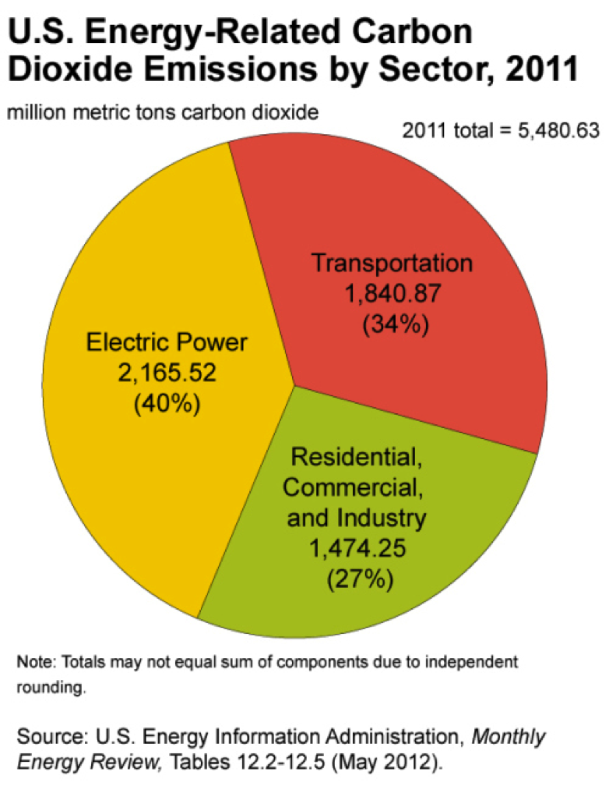
Notes:
Humans produce 16 billion tons of CO2 each year
Just focus on transportation which spits out almost 2 million metric tons of “human” – caused CO2 a year in the US alone.
- This is largely caused by burning fossil fuels
o Oil (used for gasoline),
o natural gas, and
o coal

Slide 9
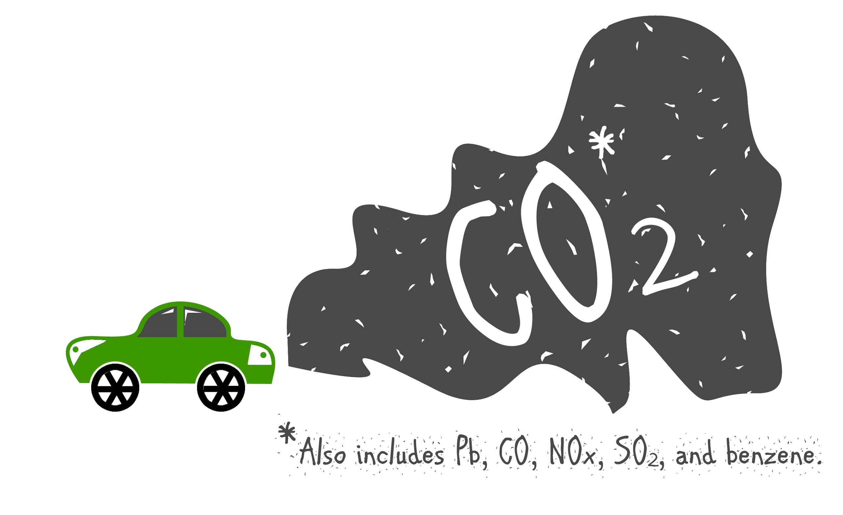
Notes:
Gasoline burning cars are a big part of that.
> 1/5th of the world’s CO2 – the most abundant greenhouse gas – comes from gasoline powered cars and trucks
Cars and trucks also produce chemicals in amounts thousands of times > than natural levels which
¬ pollute the air
and cause lung illnesses like asthma -- the # 3 cause of death in the world -- twice the death rate of AIDS.

Slide 10
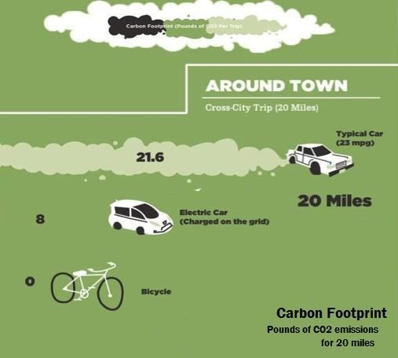
- Source: One Block off the Grid-
Notes:
Human-caused CO2 is referred to as our “carbon footprint.”
When a typical car drives 20 miles around town, it emits almost 22 pounds of carbon dioxide into the air EACH DAY.
Compare that:
- To an electric car like a Tesla – 8 pounds (despite no tailpipe emissions)
- And to a bike – carbon neutral = 0 pounds.

Slide 11
16 years old
“All the problems for the future revolve around the environment. If we take care of it, it’ll take care of us too.”
- Aitan
Notes:
Fast forward another 4 years – age 16:
[pause]
This year I’ve been working on two big projects.

Slide 12
regenerative bike brake
Makes biking easier so more people will bike instead of drive
Helps our planet
Reduces our reliance on cars which emit carbon dioxide (CO2), a leading cause of climate change
Improves our health
Exercise from biking is good for our hearts and keeps us fit
Lower car emissions in the air mean less air pollution and fewer respiratory illnesses
Low cost – about $10 of raw materials
Notes:
The first is a regenerative bicycle brake.
I ride my bike almost everywhere. If you've ever biked, you know how frustrating it is to stop and have to speed up again.
One night while biking home from school, I was thinking about that day’s lecture in physics class about springs and thought that maybe there's a way to store the bike's energy in a spring so that we wouldn’t have to exert so much energy each time we reaccelerate.
This idea, if it worked, would:
- Make biking easier by giving riders an extra push
- Which would prompt more people to bike instead of drive
- Which in turn would improve their health.
- And help our planet by cutting CO2

Slide 13
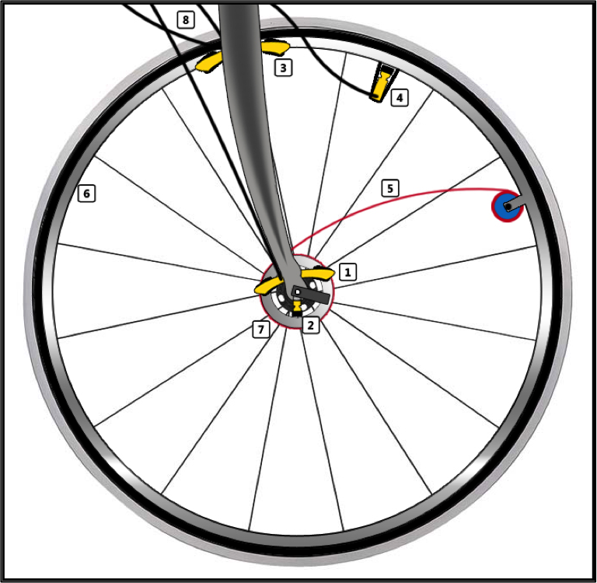
WFUCA grant project
• Fully mechanical regenerative brake
• A spring on the wheel stores energy that is otherwise lost when braking (#5)
• Releasing the spring’s tension propels the wheel forward
• Hand levers engage and disengage the spring
5
Notes:
I immediately started drawing up how the brake would work.
Look at #5:
In simple terms:
- A spring on the wheel stores the bike's energy captured when braking
- Hand levers engage and disengage the spring
- Releasing the spring propels the bike forward

Slide 14
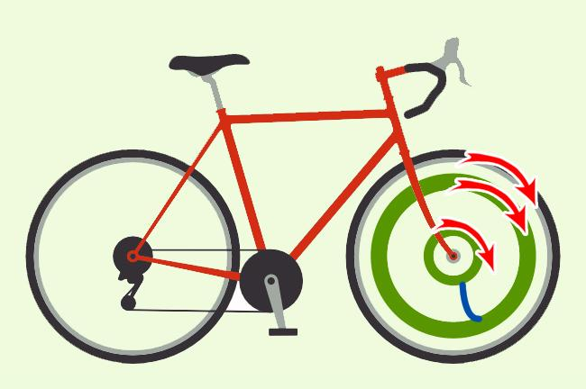
. . . normal riding
Energy capture: no
Energy release: no
.
.
Notes:
There are three riding states:
STATE 1 - Normal riding- Pedaling And Coasting.
In these drawings keep an eye on the:
Small green circle (inner bearing)
Blue line (spring)
Large green circle (outer bearing)
In the normal riding state all three of these freely rotate with the wheel.

Slide 15
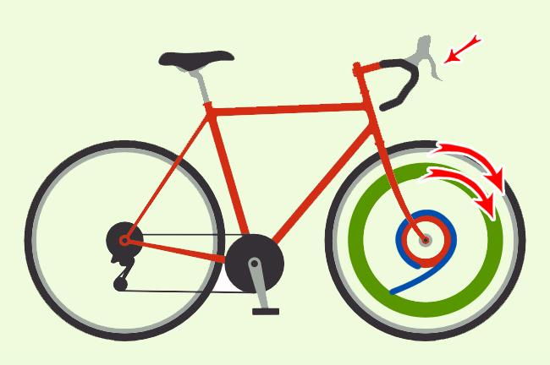
. . . braking
Energy capture: yes
Energy release: no
.
.
Notes:
STATE 2 - Braking:
O As you normally would, press the brake lever on the handlebars
▪ That engages brake pads that squeeze the Small Circle (inner bearing)
▪ Instead of the wheel as would happen on a regular bike
O Then the blue line (spring)
- winds around that inner bearing
- which slows the bike down and stores
- the rider’s kinetic energy in the spring

Slide 16
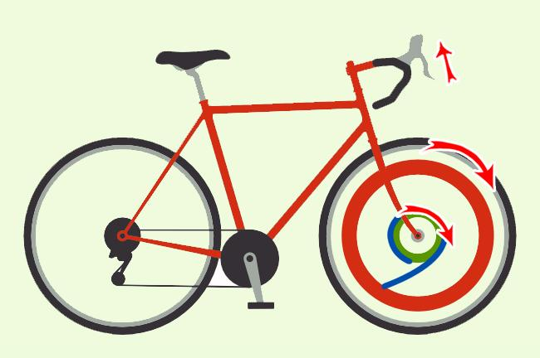
. . . accelerating with boost
Energy capture: no
Energy release: yes
.
.
Notes:
STATE 3 – For when you want the extra boost:
O Press another lever on the handlebars
▪ That engages pads that squeeze the outer bearing which stops it from rotating
▪ And releases the brake pads on the inner bearing letting that bearing turn with the wheel
O Spring unwinds, releasing energy, pushing the bike’s wheel forward….
- With the WFUCA grant money, I plan to build a prototype and make some for others to use.

Slide 17
app for cause campaign creators
amplify your message for social good
sound-board.org
sound-board.org/app
Notes:
My other project this year is a mobile app for social entrepreneurs.
Having run kidEarth I knew how hard it is to let people know about your project and how hard it is to enlist their help. make phone calls, send emails, distribute flyers, etc.
The Soundboard app for cause creators changes all of that.
This app gives social entrepreneurs an easy way to
- establish a web presence and
- promote and manage their cause campaigns.
With content that they create - including pictures and words to help them gain volunteers or donations – in just 3 minutes the app will generate a unique webpage for their charity projects.
And allow cause creators to tell others about it quickly and broadly
- To Social Network groups and
- Individuals and volunteer teams.
And it’s free!

Slide 18
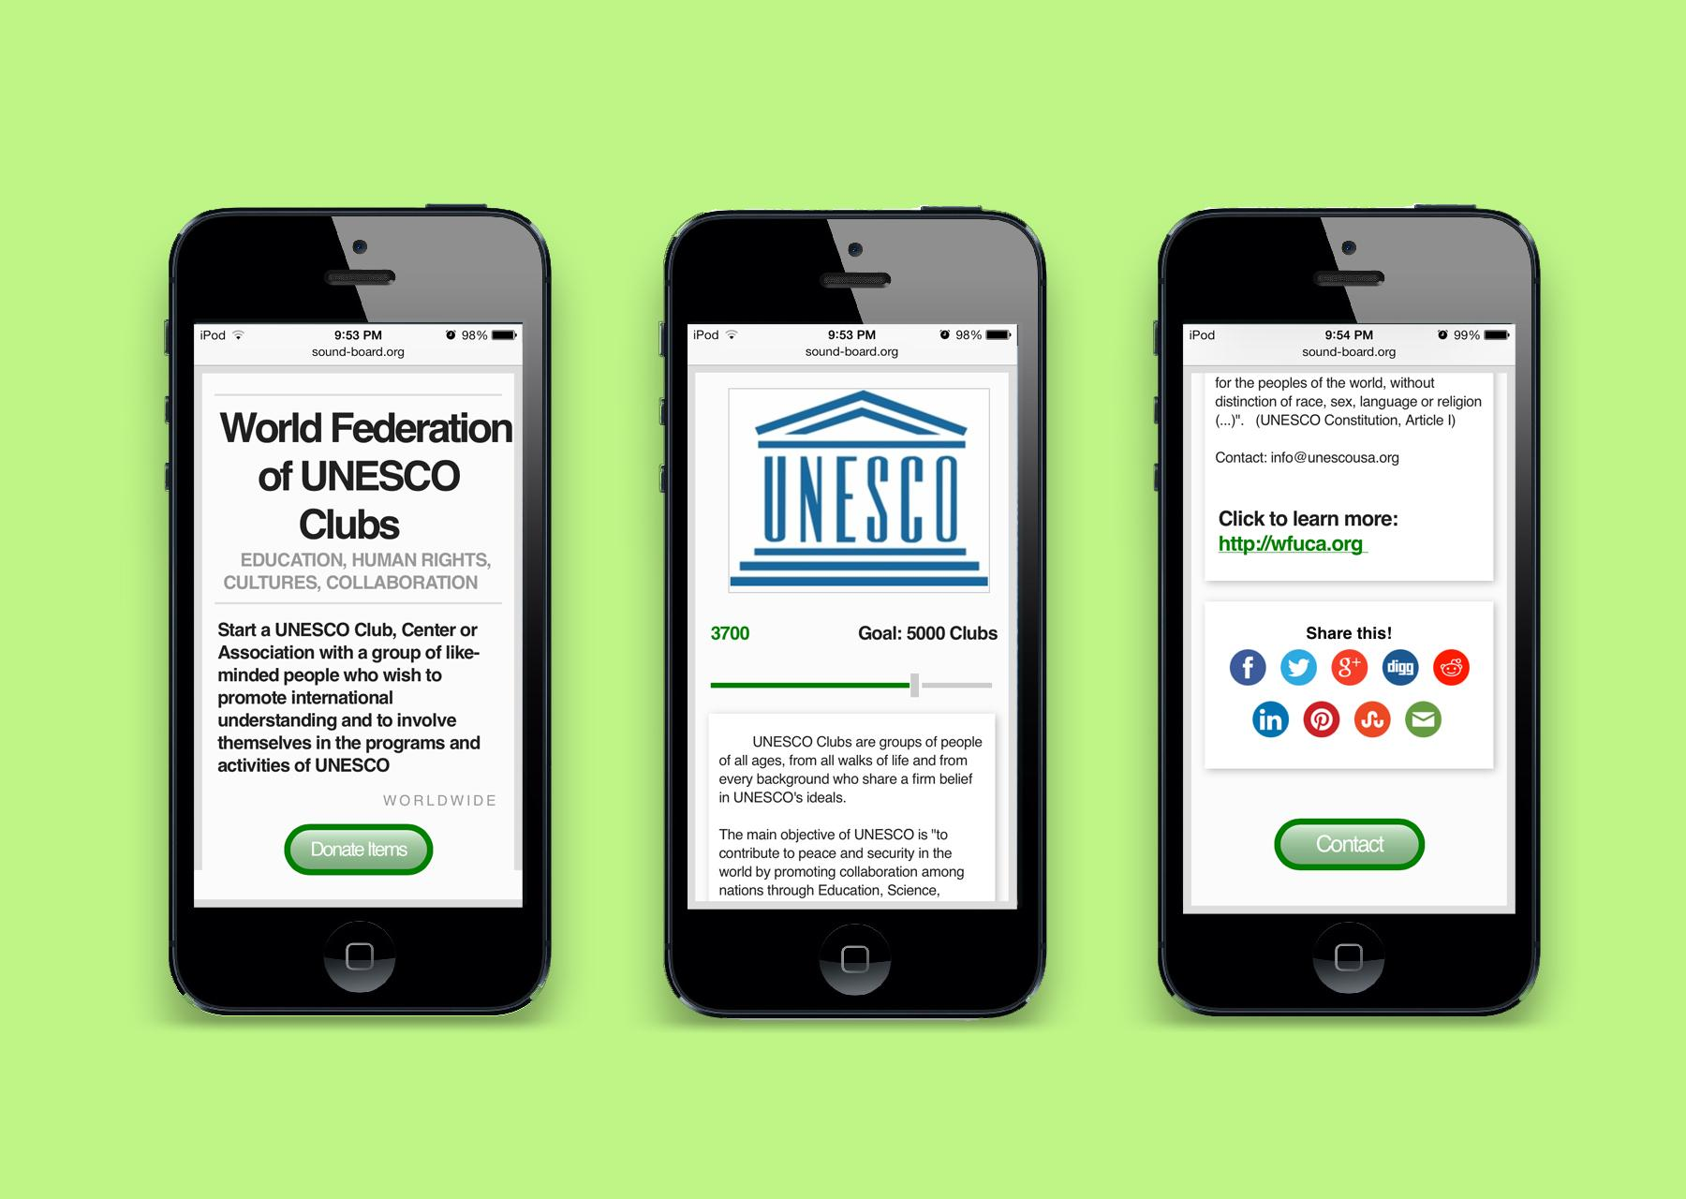
sound-board.org/app/33
Notes:
If you pull out your smart phone, tablet or laptop and it is connected to the internet, type in this URL: sound-board.org/app/33
To see a campaign app I made for WFUCA.

Slide 19
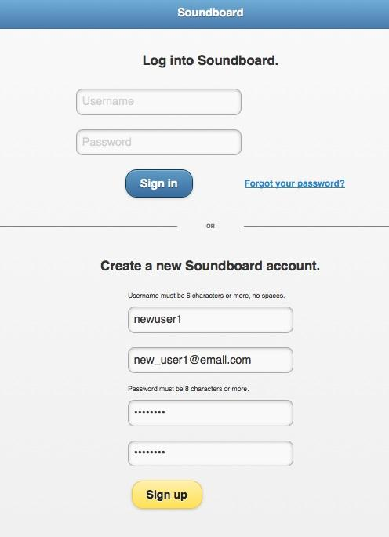
Step 1. Create an account at sound-board.org/app
Notes:
Here’s how I did it
Step 1. Went to sound-board.org/app to create an account

Slide 20
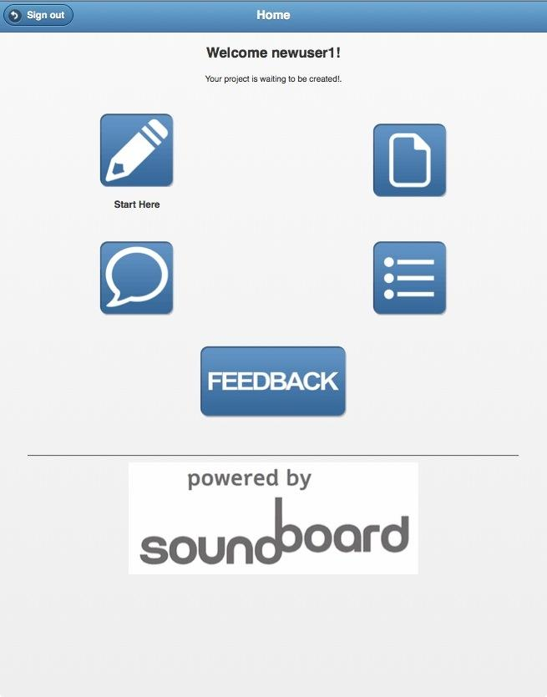
Step 2. Click “Start Here”
Notes:
Which brought me to this page where Step 2 I clicked “Start Here”

Slide 21
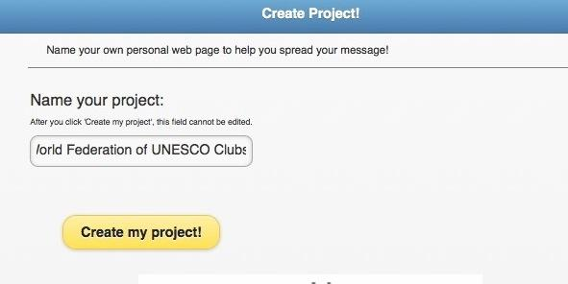
Step 3. Name your project
Notes:
Step 3. I named my project

Slide 22
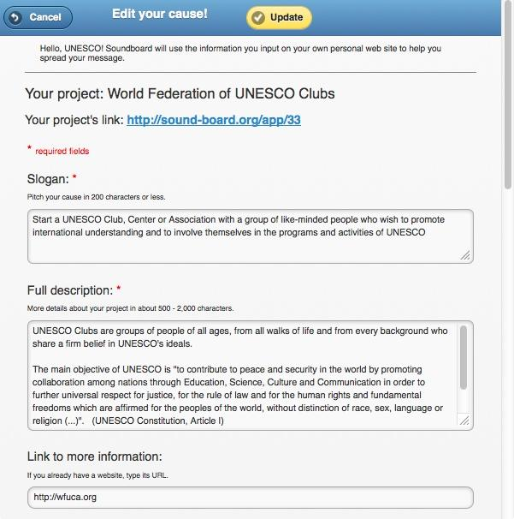
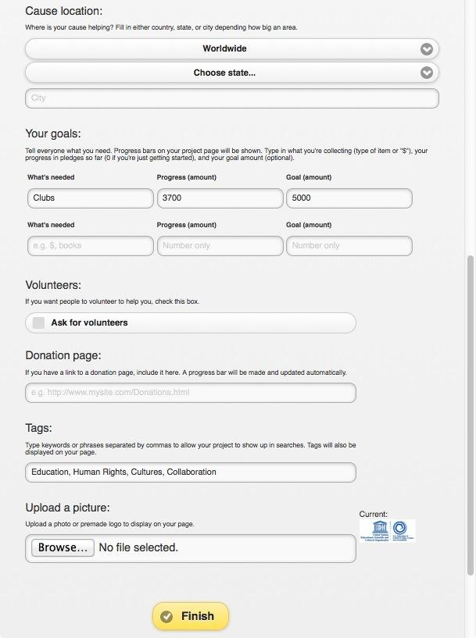
Step 4.
Fill in the fields
Notes:
Step 4. I filled in the fields with everything I wanted for the webpage
The fields are:
• A short cause pitch AND
• Project description
Optional are:
• a website link to the cause your project supports
• Picture from your device
• Your location
• Your goals, which means
• Items you want to collect: for example used eyeglasses or children’s books.
• Your goal. Enter how many of each item you want to collect.
Your progress. This is the number of things already pledged by donors.

Slide 23
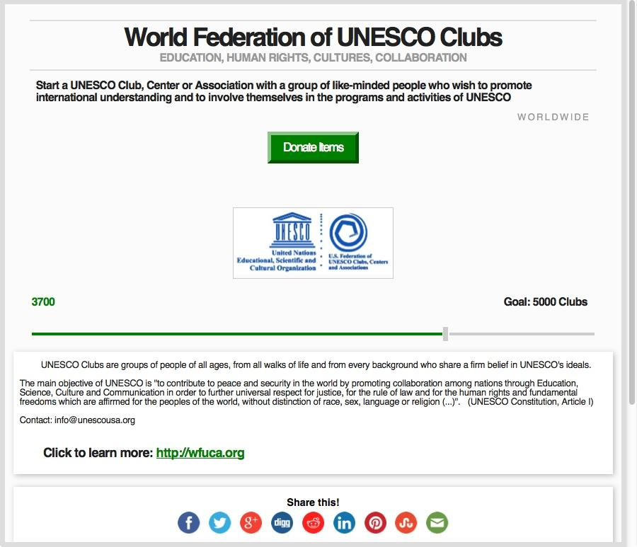
Step 5. Share with your social networks . . .
Notes:
Step 5. Done!!
The project is ready to be shared with WFUCA’s social networks . . .

Slide 24
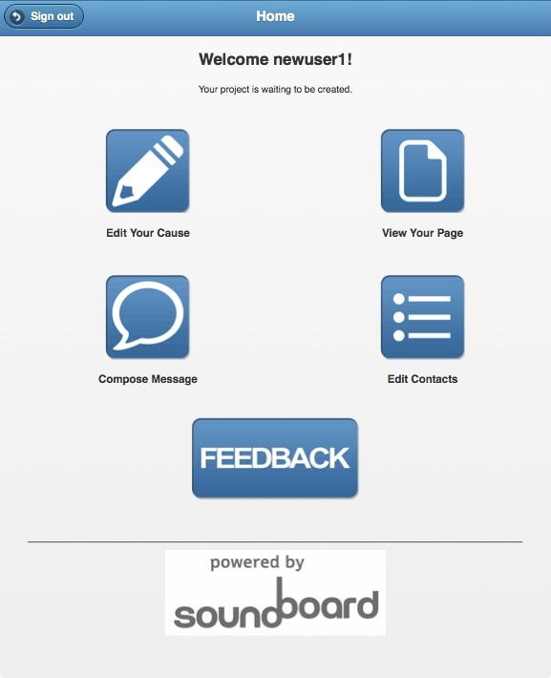
Step 6 . . . and your volunteers.
Notes:
. . . and volunteers.

Slide 25
. . . features
Designed for Cause Creators Webpage You Create On-the-Spot & On-the-Go 100% of Donations Benefit Cause | Social One-Touch Communication Controlled Content Private & Protected Tracks your Success
Notes:
Here are the app’s main features.
Notice -- ))) On-the-Spot & On-the-Go
Soundboard is designed for people out in the world, improving the world.
With you + a smartphone or tablet, anyone you meet anywhere can
- volunteer,
- pledge support for your cause,
- make electronic donations, and
- if they’re busy, you can email or text them your project link to view later.
The app works on laptops and desktops too.

Slide 26
this summer
Notes:
This summer:
- In addition to building my bike brake and monitoring app projects
- I will be interning in Tesla Motors’ Battery Division. Tesla is an electric car company based in my hometown of Palo Alto, California, and is a BIKE ride away from my home.
- While I am helping Tesla, Tesla will be helping me make my dream of emission-free transportation a reality.
- THANK YOU!!!!

