Slide 1
Critical Role of Women in the Implementation of Social Justice and Global Ethics
-----The Practice of Chinese Women
Song Lijun, Vice President
Beijing Municipal UNESCO Clubs Association
CNFUCA

Slide 2
The Significance of Women enjoy equal rights with men in social justice
Social justice is the value target which the socialist society seeks and also the internal demand of it.
The pursuit of social justice has been the basic goal and the core value of socialist country.
Women enjoy equal rights with men is an important content of social justice
本素材由hi-hoo提供

Slide 3
The proportion of women in China is 48.73% of the total population ,the same as men they are an indispensible part in social construction and development.
48.73%
Chinese government has always attached great importance to women and support the Forth World Conference on Women held in Beijing, China in 1995
Equality of men and women was established as basic national policy by the law in 1995
It was written in the Report of 18th Party Congress in 2013
本素材由hi-hoo提供

Slide 4
I. The Legal Guarantee

Slide 5
The Constitution of PRC. Stipulates:
Women in the People’s Republic of China enjoy equal rights with men in all spheres of life, in political, economic, cultural, social and family life.
The state protects the rights and interests of women, applies the principle of equal pay for equal work to men and women alike and trains and selects cadres from among women.

Slide 6
China Women’s Rights and Interests Protection Law
Came into effect on Oct.1,1992
Protect the women’s legal rights and interests
Protect the women’s equal rights with men
Give full play of the women in the construction of socialist modernization

Slide 7
The Program for the development of China Women
(1995-2000)
(2001-2010)
(2011-2020)
Main target and strategies and measures for the 6 areas of priority to development
Women and economic
Women involved in policy making and management
Women and education
Women and health
Women and law
Women and environment

Slide 8
II. The Rights of Women in China Enjoy

Slide 9
Political rights
Women enjoy equal political rights with men
Women have the right to conduct State affairs, manage economic and cultural undertakings and administer social affairs through various channels and in various ways
Women enjoy the equal right to vote and to stand for election, among deputies to the NPC and local people’s congresses at various levels, there will be an appropriate number of women deputies.

Slide 10
ii. Rights and interests relating to culture and
education
women enjoy equal rights with men in such aspects as starting school, entering a higher school, job assignment upon graduation， conferment of academic degrees and dispatch for study abroad.

Slide 11
iii. Rights and interests relating to work
The State shall guarantee that women enjoy the equal rights, with men, to work.
With exception of the special types of work or post unsuitable to women, no unit may, in employing staff and workers, refuse to employ women by reason of sex or raise the employment standards for women.

Slide 12
IV. Rights and interests to property
V. Rights & interests Relating to Person
Vi. Rights & interests Relating to marriage and family
Women’s rights and interests are guaranteed by law When a woman's lawful rights and interests are infringed upon， she has the right to request the competent department concerned for a disposition or bring a lawsuit in a people's court according to law.

Slide 13
III. Organizational guarantee

Slide 14
All-China-women’s Federation
Women’s federation in various levels
The All-China Women‘s Federation and women’s federations at various levels shall represent and uphold the rights of women of all nationalities and all walks of life， and strive for the protection of women's rights and interests.
The trade unions and the Communist Youth League organizations shall also， within the scope of their respective work， strive for the protection of women's rights and interests.

Slide 15
women are encouraged to cultivate a sense of self-respect, self-confidence, self-reliance and self-strengthening, and to safeguard their own lawful rights and interests by utilizing law
Women shall abide by the laws of the State， respect social morality and perform their obligations by law.

Slide 16
IV. The Women’s position and role in the construction of socialist society with Chinese characteristics

Slide 17
Women have played an important role both in social and ethics construction.
”Women can hold half of the sky” is the image of women in China.
The creation and dedication of women have been involved in every progress of the Chinese society

Slide 18
Women in participating decision-making has been improving
deputy in 18th Party Congress increased the proportion of 2.9%
deputy to the NPC increased 2.07%
Women involve village commission is 93.14%
93.14%

Slide 19
The proportion of women in employment in the whole society reached 46%
46%
Women is the main force of agricultural production , over 2/3
2/3
1/4
women in industry and business accounted for 1/4
Women in the technical personnel more than 40%
40%

Slide 20
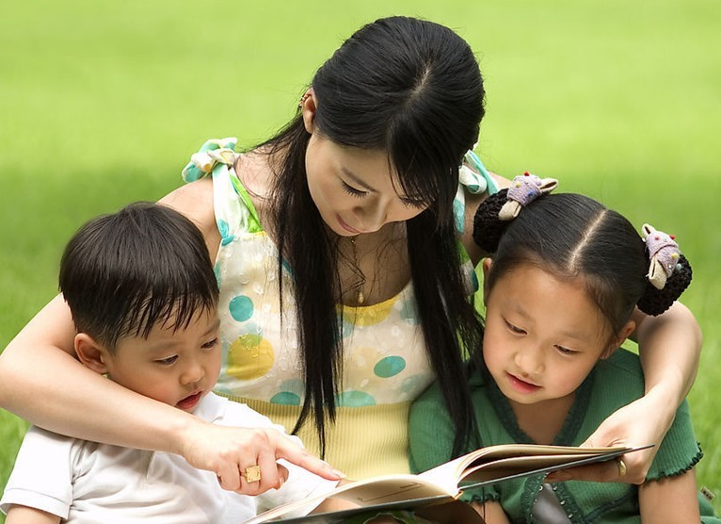
A critical characteristics of women movement in China is
-- to give play to the special advantage and role of women in the family construction
--with the natural advantage in children‘s moral cultivation, the continuation of good family style, advocating a healthy life and build a happy family, women play the leading role in family relations.

Slide 21
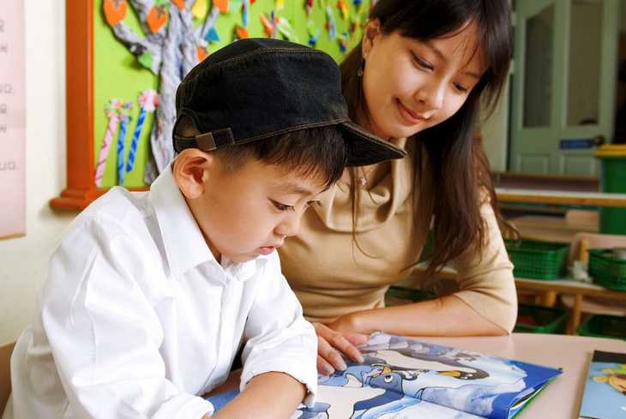
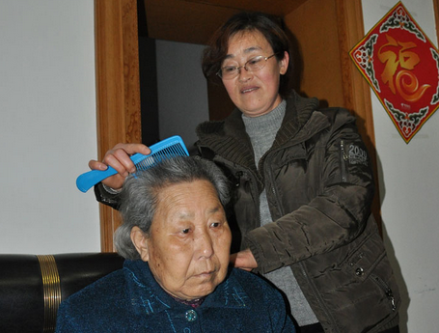
Respect the aged and love the young
Be industrious and thrifty in running one’s home
Assist husband and bring up children
Friendly neighborhood
Women could be an understanding wife ,a loving mother, good daughter and a friendly neighbor.
The above is the assurance of happy family life and meanwhile promote a harmonious society

Slide 22
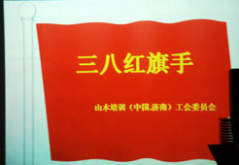
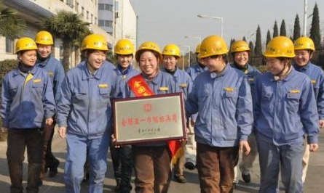
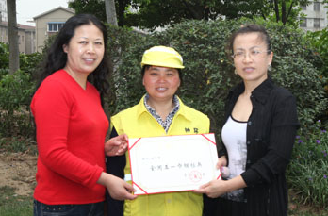
130,000 “March 8” red-banner pacesetters
more than 50,000 red-banner groups, and 150,000 women models have emerged among the women in all nationalities of China in the past five years.

Slide 23
Thank You !

